Slide 1
Machine Learning
KNN, Decision trees, Ensemble methods

Slide 2
Agenda
KNN
Decision Trees
Bias and Variance
Ensemble Methods

Slide 3
Introduction to K-Nearest Neighbour

Slide 4
Introduction to KNN
KNN Classifier is a non-parametric and instance-based learning algorithm.
Non-parametric makes no assumptions about the distribution of data and thus avoids the risks of mistaking the underlying distribution of the data.
Instance-based learning means that the algorithm doesn’t explicitly learn any parameters.
For classification, the algorithm obtains a majority vote between the K most similar instances to a given “unseen” observation. K is a count.
KNN is not suitable if the data is noisy and the target classes do not have clear demarcation in terms of attribute values.
The closest class will be identified using the distance measures like Euclidean distance.

Slide 5
Distance measures
Euclidean distance between any two points:
Manhattan distance
Euclidean Distance
Manhattan Distance
√
n
B
d(a,b) =
∑
(ai - bi)²
i=1
n
A
∑
d(a,b) =
|(a_{i}-b_{i})|
i=1
Notes:
Diagram created internally

Slide 6
Data standardization
The distance formula is highly dependent on how features / attributes / dimensions are measured.
Those dimensions which have larger possible range of values will dominate the result of the distance calculation using Euclidean formula.
To ensure all the dimensions have similar scale, we normalize the data on all the dimensions / attributes.
There are multiple ways of normalizing the data. We can use Z-score standardization.
x_{i} - x̄
Where,
x̄: mean of the variable
s: standard deviation
Z_{i} =
s

Slide 7
KNN methodology
Let’s say we have a new instances called x.
Algorithm will calculate distance between x and all the instances in the training set.
Arrange these distances in increasing order.
Find k nearest neighbors. If k = 3, then it will select three nearest instances based on the similarity measure.
Use k neighbors to determine the class of x using majority voting. (more than 1 instance in this case) of the closest instances.
Category B
x
Category A
Notes:
Diagram created internally

Slide 8
KNN Example
Humidity: (Independent variable) the percentage of humidity in the atmosphere.
Temperature: (independent variable) the temperature during precipitation.
Rain: (Target variable) indicates whether it rained or not, takes value 1 if rained and value 0 otherwise.
Will it rain if Humidity = 84 and Temperature = 37?
observation | Humidity | Temperature | Rain
1 | 58 | 19 | 0
2 | 62 | 26 | 0
3 | 40 | 30 | 0
4 | 36 | 35 | 0
5 | 87 | 19 | 1
6 | 93 | 18 | 1
7 | 79 | 16 | 1
8 | 69 | 17 | 1
9 | 62 | 33 | 0
10 | 71 | 15 | 1
11 | 55 | 33 | 0
12 | 78 | 19 | 1
Notes:
Diagram created internally

Slide 9
KNN Example
Let us choose the K = 5 and use the Euclidean distance
Compute the Euclidean distance between the new data for each instance.
For example, consider the first observation
Humidity = 58 and Temperature = 19, the Euclidean distance is
[(58 - 84)² + (19-34)²]½ = 31.623
Humidity | Temperature | Rainfall
84 | 34 | ?
Notes:
Diagram created internally

Slide 10
KNN Example
Computed the Euclidean distances for each instance with the new data and sorted the data in ascending order with respect to the Euclidean distance.
Since K = 5, consider the class labels of first five observations.
1 appears 4 times and 0 appears 1 time.
Thus for our new instance the class label is 1 (using max voting).
Implies that for Humidity = 84 and temperature = 34, it will rain.
observation | Euclidean Distance (sorted) | Class label (Rainfall)
5 | 18.25 | 1
12 | 18.97 | 1
6 | 21.02 | 1
7 | 21.59 | 1
9 | 22.36 | 0
2 | 24.6 | 0
8 | 25.00 | 1
10 | 25.55 | 1
11 | 29.27 | 0
1 | 31.62 | 0
3 | 44.55 | 0
4 | 48.04 | 0
Notes:
Diagram created internally

Slide 11
Implementation of KNN
Read the dataset
Encode Categorical Data
Split into Train and Test data
Standardize the test data & make predictions
Apply KNN Classifier
Standardize the train data
Check Performance of the model
Plot Elbow plot for multiple ‘K’ values
Select optimum ‘k’ using Elbow plot

Slide 12
K as a hyperparameter
K can range from 1 to n number of training data points.
K values can affect performance of the classifier.
K in KNN is a hyper parameter. It has to be discovered through iterations!
We can imagine K as a way of influencing the shape of the boundary between classes.
A simple approach is to use K = √n. It depends on individual cases, it is good to run through various values of K.
Odd values of K helps to avoid tie between predicted classes.
Small K | Large K
A small value of 𝐾 means that noise will have a higher influence on the result i.e., the probability of overfitting is very high. | Increases confidence in prediction. But if k is too large then decision may be skewed. Computationally expensive

Slide 13
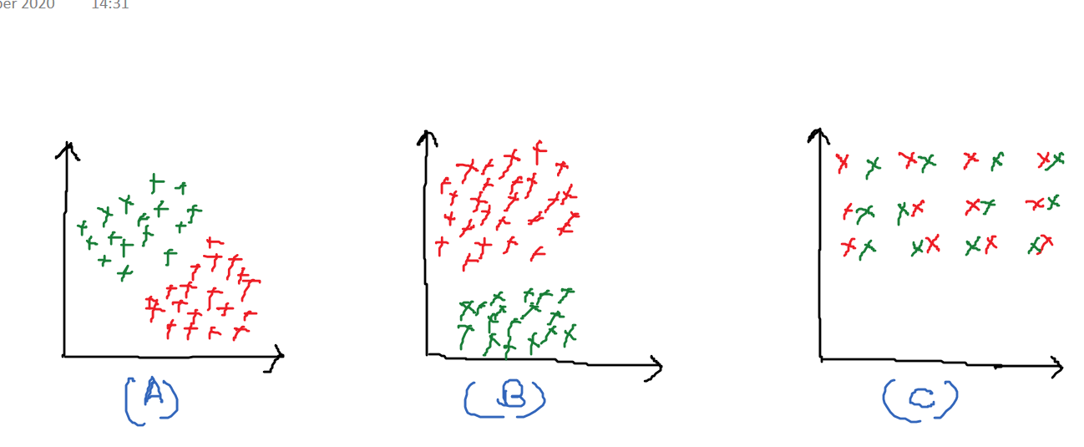
Let’s answer some questions
In which of the following Images KNN will fail to segregate the two classes denoted by red and green colors?
What happened if we build a KNN model with k=1
Notes:
C. because there is too much noise and instances have a lot of overlap
It will overfit the data

Slide 14
Introduction to Decision Trees

Slide 15
What is a Decision Tree?
It’s supervised algorithm that uses tree structure to model relationships among the features and the potential outcomes.
It does not assume any type of relationship between the independent and dependent variables unlike linear models.
It is a non-parameterized algorithm.
It breaks down dataset into smaller subsets (using multiple linear decision boundaries) with increase in depth of the tree.
It’s a flowchart for deciding how to classify a new observation.

Slide 16
Terminologies in a Decision Tree
No
Yes
Root Node: no incoming edge and zero or more outgoing edges.
Branch/subtree: a subsection of the entire decision tree
Employed
More than 55
Low
Less than 55
High
Credit score
Customer age
Loan Approved
Loan Rejected
Loan Approved
Loan Rejected
Internal Node: exactly one incoming edge and zero or more outgoing edges.
Leaf/Terminal Node: exactly one incoming edge and no outgoing edge. It holds result of all the previous functions that connect to it.
Notes:
Diagram was internally created

Slide 17
Purity of Nodes
The objective of this algorithm is to minimize the impurity, randomness, or variance as much as possible.
Impurity at a node is a measure of mixture of different classes of the target column.
There are various ways of measuring the the impurity of a node:
Entropy
Gini Index

Slide 18
Entropy
Entropy is a measure of randomness.
The entropy of a variable is calculated as in equation 1.
The entropy of two variables is the sum of product of the probability of occurrence of the class and its entropy.
Mathematically the entropy of two variables is represented as in equation 2.
A lower entropy is always preferred.
Entropy is always non-negative.
E = -Σ_{i}^{c}₌₁p_{c} log₂p_{c} ----- 1
E(T,X) = Σ_{x⥺X} P(c) E(c) ----- 2
P(c) /p_{c} : probability of occurrence of the class
(T,X): Variables in scope
E(c): entropy of the class.

Slide 19
Entropy
Used to measure uncertainty
Consider the below example
Here, 0.76 depicts that event is somewhat random.
If the chances for yes and no are 50-50 then entropy would be 1.
If all are yes/no, then entropy would be zero. Mean information gain is 100%.
Ate Today
Yes | No
7 | 2
Entropy(Ate today) = Entropy ( 7,2)
= Entropy( 0.78, 0.22)
= -((7/9)*log2(7/9) + (2/9)*log2(2/9))
= -((0.78*(-0.36) + (0.22)*(-2.18))
= -(-0.28 - 0.48)
= 0.76
Notes:
Table created internally

Slide 20
Information gain using Entropy
Information gain is the decrease in entropy at a node.
Information Gain (T,X) = Entropy (T) – Entropy(T|X)
Less the entropy, more the information gain.
To construct the decision tree, the feature with highest information gain is chosen.
Information gain is always positive.
Note (Why information gain is always positive/ can info gain be negative):
After the split of data, the purity of data will be higher as a result the entropy will always be lower. Thus, the information gain is always positive.
Here T & X refers to variables in scope.

Slide 21
Gini index
Lower the value of gini index higher the homogeneity.
Gini index is calculated by subtracting the sum of the squared probabilities of each class from one:
Calculate gini index for sub-nodes
Calculate gini for split using weighted Gini score of each node of that split
For samples belonging to one class, the gini index is 0 and for equally distributed samples, the gini index is 0.5
The gini index of a variable is calculated as:
Gini = 1-Σ_{c}^{n}₌₁p_{c}²
p_{c}: probability of occurrence of the class

Slide 22
Gini index Example
 |  | Ate Today
 |  | Yes | No
Food | Veg | 3 | 1 | 4
 | Non Veg | 4 | 2 | 6
 |  | 7 | 3 | 10
Gini for sub-node veg = (¾)*(¾) + (¼)*(¼) = 0.625
Gini for subnode nonveg = (4/6)*(4/6) + (2/6)*(2/6)
= 0.55
Weighted gini for split on food = 0.4*(0.625)
0.6*(0.55) = 0.58
Gini index = (1-0.58) = 0.42
Similarly, we can calculate weighted gini for other attributes if there is any.
And split the node using attribute having minimum gini index.

Slide 23
Information gain using Gini index
Information gain is the decrease in Gini index at a node.
Information Gain (T,X) = Gini Index (T) – Gini Index(T|X) where T&X refers to variables in scope
It is similar to that of the information gain using entropy.
Information gain is the reduction in gini index.

Slide 24
Pruning
How to decide optimal size of a tree
Pruning is used to reduce size of a decision tree
It removes nodes that do not provide additional information
Decision tree tends to get overfit with training sample and becomes too large and complex. A complex and large tree poorly generalizes the new samples data whereas a small tree fails to capture the information of training sample data.
Pruning may be defined as shortening the branches of tree. The process of reducing the size of the tree by turning some branch node into leaf node and removing the leaf node under the original branch.

Slide 25
Regularization
Decision trees do not assume a particular form of relationship between the independent and dependent variables unlike linear models for e.g.
Decision tree is a non-parameterized algorithm unlike linear models where we supply the input parameters
Decision tree tries to fit the train data perfectly which leads to overfitting
To avoid overfitting, we need to restrict the DT’s freedom during the tree creation. This is called regularization

Slide 26
Regularization
The regularization hyperparameters depend on the algorithms used
max_depth – Is the maximum length of a path from root to leaf (in terms of number of decision points)
min_sample_split - A limit to stop further splitting of nodes when the number of observations in the node is lower than this value
max_leaf_nodes – maximum number of leaf nodes in a tree
max_feature_size - max number of features that are evaluated for splitting each node

Slide 27
Underfitting
When the ML model built is not able to completely learn the trend from the available data.
Example- accuracy is 70% where expectation is to get 90%
It usually occurs:
When the model is too simple and not able to learn the trend properly
While trying to avoid overfitting by stopping the training data feed to the model at an early stage;
Due to insufficient features considered while feeding training data
Notes:
Image created internally

Slide 28
Overfitting
Occurs when the ML model built tries to learn more than required and results in a complex model.
Overfitting usually occurs in a model while trying to learn all data points in a training data and end up memorizing them.
Ex. training error is 95% but test error is 80%.
Overfitting can be avoided by following methods:
Ensemble techniques
Removing unwanted features
Increase data size for training
Regularization
Stop feeding train data earlier
Notes:
Image created internally

Slide 29
Types of error
There are 3 major errors that cause ML models to perform poorly:
Bias error: Caused due to presumptions about the data.
Variance error: Caused due to memorizing the data as opposed to learning.
Random error: Caused due to the unforeseen changes that we cannot do anything about.

Slide 30
Bias error
Bias error is caused due to presumptions about the data to make the approximation of the target function easier.
Bias error is the error which signifies the amount by which a model’s prediction varies from the target value for the training data. Ex. Training error:- 30% (If accuracy is 70%)
Due to introduction of bias error an algorithm might learn fast but the prediction will not be reliable.
It generally results in a underfit model.

Slide 31
Variance error
Variance error indicates how much the predictions will vary for a new/unseen data compared to predictions on training data.
Introduction of variance leads to overfitting in the model.
A model with low variance means that the model is able to generalise well on the unseen data
Linear regression, logistic regression are few algorithms with low variance, whereas decision trees is an example of algorithms with high variance.

Slide 32
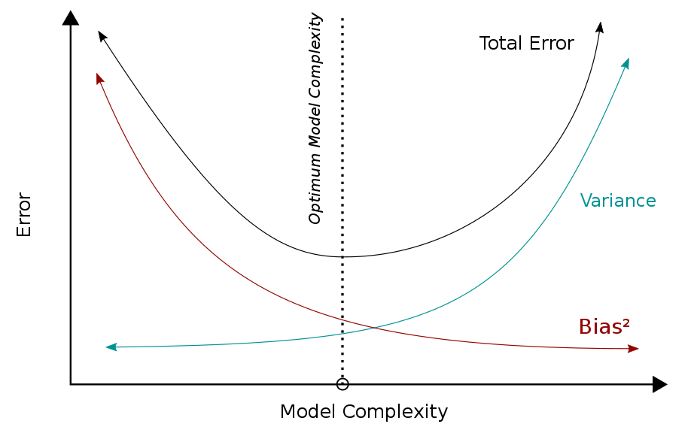
Bias Variance Trade Off
The primary goal of an algorithm is to achieve a model with precise prediction i.e low variance and low bias.
To achieve this goal we need to find a value which is between the error value of bias and variance.
This tension between bias and variance where the the value of both bias and variance are the lowest is called as bias variance trade off.
Notes:
Image source: https://commons.wikimedia.org/wiki/File:Bias_and_variance_contributing_to_total_error.svg

Slide 34
Let’s answer some questions
Can we use the decision trees for regression (for predicting continuous data)?
If one were to let a decision tree grow to the fullest extent, what would the impurity of individual leaf nodes be?
Write conclusion for the following scenarios?
Training error | Test error | Bias(Training error) | Variance(Test error - Training error) | Conclusions
1% | 11% | 1% | 10% | ?
30% | 32% | 30% | 2% | ?
Notes:
Yes
0. Explanation:- When a decision tree is let to grow to its fullest extent, individual leaf nodes become completely homogeneous therefore, impurity is zero. It is a clear case of over-fitting
High variance, overfitting
High Bias, underfitting

Slide 35
Ensemble Methods

Slide 36
Need for Ensemble Learning
Ensemble techniques attempt to reduce Bias and Variance errors, and potentially produce better predictions without having to compromise on either one of them.
Instead of one model deciding what the final prediction should be, multiple models together make the decision.
The general idea is that collective wisdom supersedes individual wisdom.

Slide 37
What is Ensemble Learning?
Training multiple models instead of a single model, and combining all of them to make predictions is called Ensemble Learning.
The idea of ensemble techniques in ML is to create a group (Ensemble) of algorithms and use specified metric of aggregation to generate results for the problems.

Slide 38
Ensemble Methods
Ensemble
Bagging
Stacking
Boosting
Simple bagging
Random Forest
Voting
Meta model
Ada boosting
Gradient Boosting
Notes:
The diagram is created internally

Slide 39
Ensemble Methods
Bagging (Bootstrap aggregating): Train a bunch of models independently, each on different subsets of data, and make predictions by taking the average or majority vote.
Boosting: Train a bunch of models one after the other, each on the same data where every subsequent model tries to fix the mistakes made by the previous model.
Stacking: Train a bunch of models independently on the same data, and train a meta-model by using the predictions of the individual models as training data.

Slide 40
Bagging

Slide 41
Resampling: Bootstrapping
In practice (unlike in theory), we have only one training set X.
We can generate multiple training sets by using bootstrapping.
X’ = {x | x is drawn at random with replacement from X} and |X’| = |X|
Each bootstrap sample is created by randomly sampling the dataset with replacement.
Original | Bootstrap 1 | Bootstrap 2 | Bootstrap 3 | Bootstrap 4 | Bootstrap 5
1 | 1 | 2 | 1 | 1 | 2
2 | 1 | 2 | 2 | 3 | 2
3 | 2 | 3 | 3 | 3 | 1
4 | 3 | 4 | 4 | 5 | 3
5 | 3 | 5 | 4 | 5 | 4

Slide 42
Bagging: Bootstrap Aggregation
Let’s construct N bootstrap samples of the training set X, X₁, …, X_{n}
Apply learning algorithm to each sample X_{n} to obtain hypothesis h_{n}
Every base estimator gets trained with one unique bootstrap sample (X_{n}).
Each model learns very well from the data without compromising on complexity.
This way, individual models have low bias and high variance, but at the ensemble level, (the models put together) has low variance.
The predictions of the base estimators are aggregated by taking the average (in case of regression) or mode(in case of classification) to get the final prediction.

Slide 43
Bagging: Bootstrap Aggregation
Bootstrap sample 1
Estimator 1
Bootstrap sample 2
Estimator 2
X
Mode/Mean
ŷ̂
Bootstrap sample 3
Estimator 3
Bootstrap sample n
Estimator n
X - Input
ŷ̂ - Predictions
Notes:
The diagram is created internally

Slide 44
Random Forest
Random forest is a natural progression of Bagging.
Unlike Bagging, Random forest can only be used with decision trees.
It introduces two sources of randomness:
Just like in Bagging, the algorithm makes bootstrap samples from the original data.
Random vector method: At each node, best split is chosen from a random sample of m attributes instead of all attributes. Typically, m = √(𝑡𝑜𝑡𝑎𝑙 𝑛𝑢𝑚𝑏𝑒𝑟 𝑜𝑓 𝑓𝑒𝑎𝑡𝑢𝑟𝑒𝑠).
Every estimator gets potentially different set of features.
The above step makes sure that the individual trees are diverse and do not correlate with each other.
The stage after the estimators is identical to Bagging.

Slide 45
Random Forest Algorithm
Random Forest Algorithm:
For a given training data d = 1 to D consider samples S1,S2 …. SN of size N.
Build a random forest tree T_{d} for these samples by repeatedly following the below steps:
Given X features in a dataset randomly pick variables r.
Select the best feature among these r variables.
Split the nodes into two children nodes.
Capture the ensemble of the trees. {T_{d}}^{D}₁
To draw the prediction at a new point x:
Regression: f^{D}_{rf}(x) = 1/D Σ^{D}_{d=1}T_{d}(x)
Classification: C^{rf}_{D}(x) = majority vote{C_{d}(x)}^{D}₁, where C_{d}(x) is the class prediction of d^{th} random forest tree.
Notes:
The diagram is created internally

Slide 46
Random Forest
Bootstrap sample 1
m random features for every split
Estimator 1
Bootstrap sample 2
m random features for every split
Estimator 2
X
Bootstrap sample 3
m random features for every split
Estimator 3
Bootstrap sample n
m random features for every split
Estimator n
ŷ̂
Mode/Mean
Notes:
The diagram is created internally

Slide 47
Difference between simple bagging and Random forest
Original
X1 | X2 | X3 | X4
1 | 100 | Y | 1
2 | 200 | N | 4
3 | 300 | Y | 9
4 | 400 | N | 16
5 | 500 | Y | 25
Bootstrap sample-1
X1 | X2 | X3 | X4
1 | 100 | Y | 1
2 | 200 | N | 4
2 | 200 | N | 4
4 | 400 | N | 16
5 | 500 | Y | 25
Bootstrap sample-2
X1 | X2 | X3 | X4
1 | 100 | Y | 1
1 | 100 | Y | 1
3 | 300 | Y | 9
4 | 400 | N | 16
5 | 500 | Y | 25
Sample-1 for Random forest
X1 | X2 | X4
1 | 100 | 1
2 | 200 | 4
4 | 400 | 16
4 | 400 | 16
5 | 500 | 25
Sample-2 for Random forest
X1 | X2 | X3
1 | 100 | Y
2 | 200 | N
4 | 400 | N
4 | 400 | N
5 | 500 | Y
Notes:
Table created internally

Slide 48
Boosting

Slide 49
Boosting
Combines several weak learners into a strong learner.
The idea is to train predictors sequentially trying to correct its predecessors.
In Boosting, the trees are grown in an adaptive way to remove bias.
Boosting is iterative and adaptive:
Looks at the errors from previous classifiers to decide what to focus on for the next iteration.
Successive classifiers depend on their predecessors.
Key idea: Place more weight on “hard” examples (i.e., instances that were misclassified on previous iterations).
Records that are classified correctly will have their weights decreased.

Slide 50
Boosting
X
Estimator 1
x1
Estimator 2
x2
Estimator 3
x3
Estimator n
ŷ̂
Notes:
The diagram is created internally

Slide 51
Ada Boosting
In adaptive boosting, the samples that were incorrectly classified by the preceding tree, gain more weight (we either use weighted Gini index when building the subsequent tree or simply duplicate the misclassified samples. Either way we increase the importance of the misclassified samples).
At every step, weights for the model are updated based on how well the preceding classifier has performed.
Unlike in Bagging and RF, in boosting the final prediction is made by taking a weighted average/mode instead of a simple average/mode.
The trees that have performed better get more power to decide what the final prediction should be.
Notes:
Diagram is created internally

Slide 52
Ada Boosting
Adaptive Boosting (Ada Boost): uses weight initialization and manipulation to focus more on the under fitted observations.
X2
X2
X2
X2
X1
X1
X1
X1
Weak learner
Decision stump fitted on the dataset
Weights of misclassified instances increased and a new learner focuses more on the instances with larger weight.
Weights of misclassified instances increased and a new learner focuses more on the instances with larger weight.
Aggregating the predictions made by all the learners involved in the ensemble.
Notes:
Diagram is created internally

Slide 53
Gradient Boosting
It is an optimization problem with an objective to minimize the loss of the model by adding weak base learners using gradient descent method.
It is a stage-wise additive algorithm where a new base model is added one at a time
and the previously added models remain unchanged.
Gradient Boosting works by adding one weak learner at a time.
The output from each weak tree is added sequentially to get the final prediction.
Thus Gradient boosting works by taking one small step in the right direction at a time!.
Also known as GBM, Gradient Boosting Machine.

Slide 54
Gradient Boosting
It is similar to AdaBoosting in a way that both carry out model building sequentially. However, instead of changing the weights of records, we make predictions for the errors made by the preceding tree.
It is easier to understand the algorithm in the context of regression as calculating residuals is straight forward, in case of classification we use log(odds) and probabilities to calculate the “residuals” instead of the absolute numbers the way we do for regression.

Slide 55
Gradient Boosting Algorithm
Set f(x) = 0 and r_{i}=y_{i} for all i in the training set.
For b = 1,2,3,....B, repeat:
Fit a tree fb with d splits (d+1 terminal nodes) to the training data (X,r).
Update f by adding in a shrunken version of the new tree:
f(x) <- f(x) + λf^{b}(x)
Update residuals,
r_{i} <- r_{i} - λf^{b}(x_{i})
Output the boosted model,
f(x)= Σ^{B} _{b=1}λf^{b}(x)
f(x) - predictions
r- residuals
y-actuals
λ - learning rate
f^{b}(x) - predictions of b^{th} model

Slide 56
Ada Boosting v/s Gradient Boosting
AdaBoost | Gradient Boost
Mostly made of stumps (Tree with a root and two leaves) Stumps are scaled such that each stump has different amount of say in the final prediction Shortcoming of the base learner is identified by high-weight samples | Starts with a leaf. Then build trees with 8 to 32 leaves. So, it does not restrict the size of the trees Output from each tree is scaled by a learning rate, however all trees have an equal amount of say in the final prediction Shortcoming of the base learner is identified by gradients
Notes:
Table created internally

Slide 57
Bagging Vs Boosting
Bagging | Boosting
Samples are independent of each other Helps to reduce variance error Each model is weighted equally Data subsets used for training are drawn randomly by replacing the data from the entire dataset To be used when the classifier has high variance which in turn creates over fitting problem. Example: Random Forest Algorithm | Samples are not independent of each other Helps to reduce bias error Each model is weighted on the basis of their performance The new subset has the misclassified elements from previous models To be used when classifier has high bias which in turn creates underfitting problem. Example: Ada Boost
Notes:
Table created internally

Slide 58
Stacking

Slide 59
Stacking
It is an ensemble method which uses prediction of multiple algorithms to build a new model.
The new model will be used for predicting the outcome on the test dataset.
The advantage of stacking is that it captures the capabilities of the models performing well and make final predictions rather than making predictions based on any single model using hard / soft aggregation.

Slide 60
Stacking – Voting classifier
In voting technique multiple ML algorithms are combined together to form an ensemble. We can use aggregating strategy to generate predictions.
Most common aggregating techniques are hard voting and Soft voting.
Below is an example of recognizing an animal as dog or cat using voting Ensemble method.
Majority Rule Voting – Hard Rule
LR
Dog: 70%
Cat: 30%
LR
Dog
Soft voting – Aggregating the probabilities of classification.
KNN
Dog: 34%
Cat: 66%
Dog: 194%
Cat: 106%
KNN
Dog
Dog
Dog
Aggregating the occurences
Hard voting is preferred over soft voting since not all algorithms are well equipped to generate the probabilities of class labels
DT
Dog: 90%
Cat: 10%
DT
Dog
Notes:
The diagram is created internally

Slide 61
Stacking – Voting classifier
The model pool we use in stacking does not have to be homogenous.
We can have different models as our base estimators example: 2 decision trees, 1 logistic regression, 1 knn – This list can constitute a pool of base estimators for the overall Voting classifier.
Model 1
Model 2
X
Voting
ŷ
Model 3
Model k
Notes:
The diagram is created internally

Slide 62
Stacking – Meta model
We train multiple models (potentially different algorithms) using the same data, the predictions coming out of these models are used as training data for a meta-model, the final prediction is the prediction we get from the meta-model
Model 1
ŷ₁
Model 2
ŷ₂
X
Meta-model
ŷ
Model 3
ŷ₃
Model k
ŷ_{k}
Notes:
The diagram is created internally

Slide 63
Let’s answer some questions
Does Bagging improve the performance by aggregating the result of weak learners?
Is a decision tree an ensemble model?
Can we use logistic regression as a base model for bagging classifier?
How does boosting algorithms convert weak learners to strong learners?
Notes:
YES
No
Yes
By giving more importance to misclassified predictions (either by assigning weights or duplicating them)

Slide 64
Summary
KNN
Distance measures and data standardization.
KNN methodology and Implementation of KNN.
K as a hyperparameter.
Decision trees.
What is a Decision tree?
Terminologies in a decision trees.
Entropy, Gini index, and information gain.
Pruning and regularization.
Bias and Variance.
Underfitting and overfitting, types of error.
Bias and Variance error, Bias Variance trade off.
Ensemble Methods.
Bagging & Boosting
Stacking.
Notes:
The diagram is created internally

Slide 65
Thank you Happy learning ☺

